Slide 1

Testing Techniques
The Theory of testing
QA
Fundamentals
SoftUni Team
Technical Trainers
Software University
http://softuni.bg

Slide 2

Table of Contents
Static Testing Techniques
Dynamic Testing Techniques
Specification-based (Black-Box) Testing Techniques
Structure-based (White-Box) Testing Techniques

Slide 3
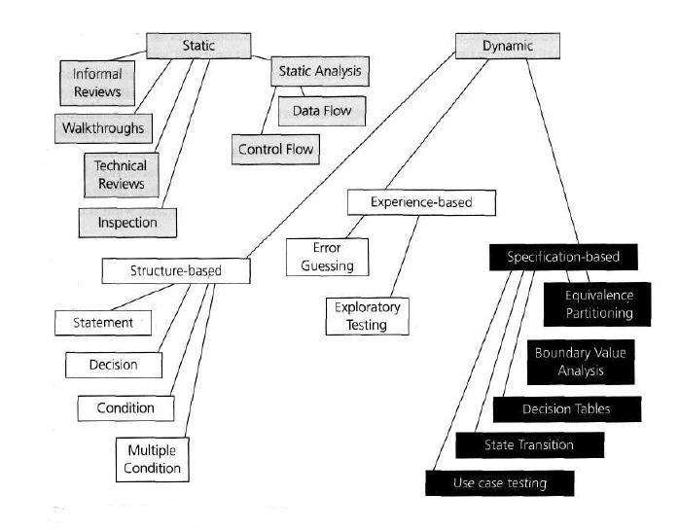
Graph of contents

Slide 4
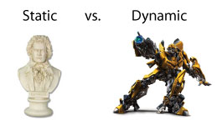
Static vs. Dynamic Techniques
Static tests
Aim to find problems in the design or concept of the prod.
Code is NOT being executed.
Dynamic tests
Aim to find problems in an instance of the product.
Code execution is mandatory.

Slide 5

Static Testing Techniques

Slide 6
Static Testing Techniques

Slide 7


Static Testing Techniques
Reviews
A human investigator is the primary defect finder
Static Analysis
Testing is done by code review tools

Slide 8
Dynamic Testing Techniques

Slide 9
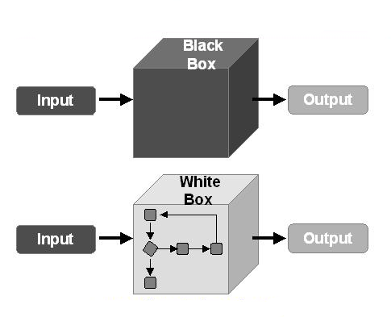
White-Box vs. Black-Box Testing

Slide 10
Dynamic Testing Techniques

Slide 11
Black Box Testing Techniques

Slide 12

Black-Box Testing Techniques
Some of the most used Black Box testing techniques are:
Equivalence Partitioning
Boundary Value Analysis
Decision Tables
State Transition Tables
Use-Case Testing

Slide 13
Equivalence Partitioning

Slide 14
What is Equivalence Partitioning?
Equivalence partitioning:
Equivalence partitioning is a software testing technique that divides the input data of a software unit into partitions of equivalent data
Test cases are designed to cover each partition at least once

Slide 15
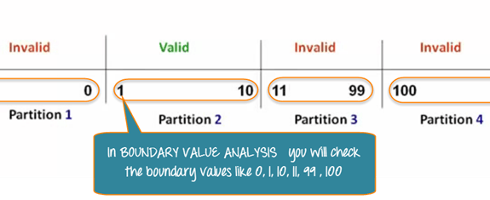
Why Equivalence Partitioning?
Equivalence partitioning aims to reduce the total number of test cases to a feasible count
Exhaustive testing of all possible input / output values is usually impossible

Slide 16
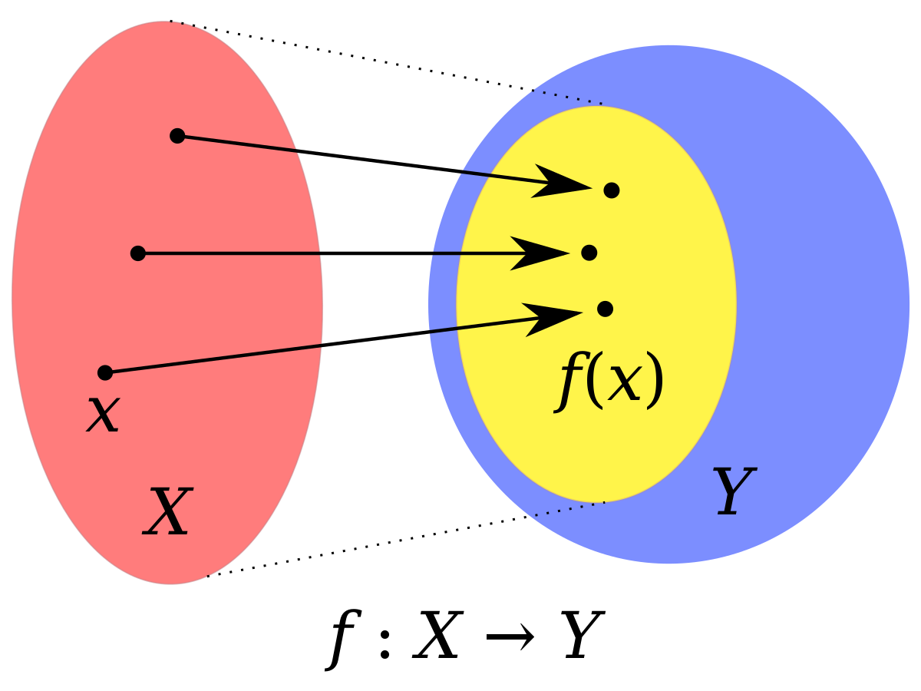
Input / Output Domains
A domain can be formed of:
Input field
Output field
Test precondition or post condition
Configuration
Etc. - anything we're interested in testing

Slide 17

Splitting Domains Into Partitions
The operation of equivalence partitioning is performed by
splitting a set (domain) into two or more subsets
All the members of each subset share some trait in common
This trait is not shared with the members of the other subsets

Slide 18
Boundary Value Analysis

Slide 19

What Is Boundary Value Analysis ?
Conceptually, boundary value analysis is about testing the edges of equivalence classes
When the members of an equivalence class are ordered Boundary value analysis can be seen as an extension of equivalence partitioning

Slide 20

Why Should This Work?
Many bugs occur due to careless usage of indexes, operators
for example < instead of <= etc.
If a software can operate on the edge of its capabilities, it will almost certainly operate well under normal conditions

Slide 21


What is a Boundary Value?
The point where the expected behavior of the system changes
The values could be either input or output ranges of a software component
invalid
valid
invalid
1
31
…-2-1 0
2 3 4 ….
…28 29 30
32 33 …
Days of a month

Slide 22
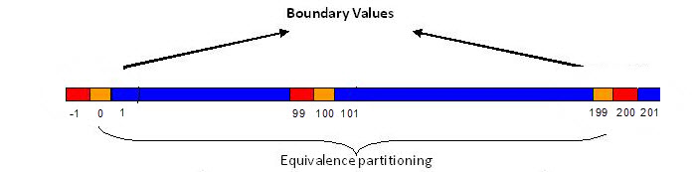
Sub-Boundary Conditions
Some boundaries, that are internal to the software aren't necessarily apparent to an end user but still need to be checked by the software tester
Every data structure has it’s limitations

Slide 23
Decision Table Testing

Slide 24
Decision Table Testing
Decision tables testing connects combinations of conditions with the actions that should occur
What kind of bugs are we looking for?
Under some combination of conditions, a wrong action might
occur

Slide 25
Example: Decision Table Testing
Credit card example:
If you are a new customer and you want to open a credit card account then there are three conditions first you will get a 15% discount on all your purchases today, second if you are an existing customer and you hold a loyalty card, you get a 10% discount and third if you have a coupon, you can get 20% off today (but it can’t be used with the ‘new customer’ discount). Discount amounts are added, if applicable.

Slide 26
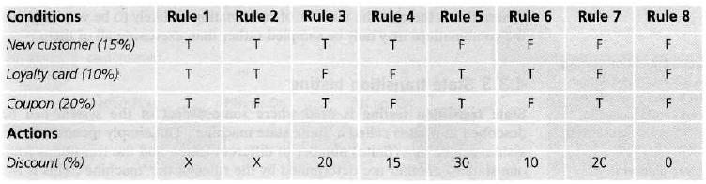
Example: Decision Table Testing
Credit card example:

Slide 27
State Transition Testing

Slide 28

What is State Transition Testing?
A black-box test design technique in which test cases are designed to execute valid and invalid state transitions

Slide 29
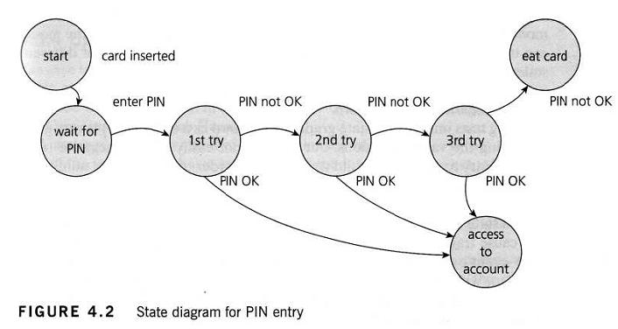
State Diagram Testing

Slide 30
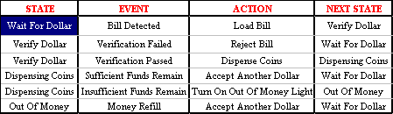
State Transition Tables
Each row in a state transition table has four fields:
Current state
Event/condition
Action
New state

Slide 31

What do we expect to find ?
We're looking for situations where the wrong action or the
wrong new state occurs in response to a particular event
State transition tables force us to consider combinations of
states with event/condition combinations that we might have
forgotten

Slide 32
Use-Case Testing
A use case is a description of a particular use of the system by an actor (a user of the system).
Each use case describes the interactions the actor has with the system in order to achieve a specific task (or, at least, produce something of value to the user).
Actors are generally people but they may also be other systems.

Slide 33
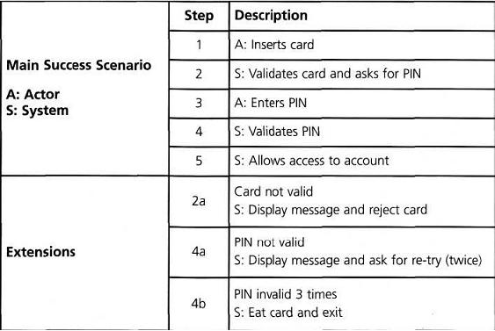
Use-Case Testing

Slide 34
White-Box Testing Techniques

Slide 35
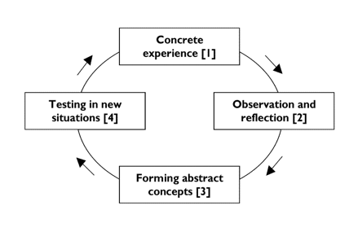
Experience Based White-Box Testing

Slide 36
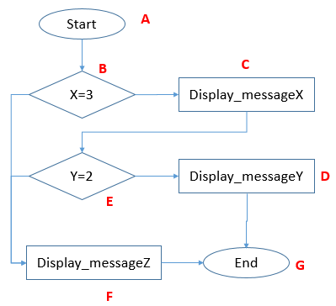
Structure Based White-Box Testing Metrics
Statement Coverage
Branch/Decision Coverage
Path Coverage

Slide 37
Useful Links
Static testing tool (validator): https://validator.w3.org/
Top 40 Static Analysis tools: http://www.softwaretestinghelp.com/tools/top-40-static-code-analysis-tools/
Demo test environments:
https://lab.uk.qateam.eu/
https://box.uk.qateam.eu/04/epbva/

Slide 39
Diamond Partners

Slide 40
Diamond Partners

Slide 41





Trainings @ Software University (SoftUni)
Software University – High-Quality Education, Profession and Job for Software Developers
softuni.bg
Software University Foundation
http://softuni.foundation/
Software University @ Facebook
facebook.com/SoftwareUniversity
Software University Forums
forum.softuni.bg

Slide 42

License
This course (slides, examples, demos, videos, homework, etc.) is licensed under the "Creative Commons Attribution-NonCommercial-ShareAlike 4.0 International" license

